Slide 1
Classifier: Logistic_Regression_with_L2_norm
Features: TfidfVectorizer, word bigrams
Accuracy: 87%
9640
9676
9702
9703
9705
9706
9716
9717
9719
9720
9721
9724
9728
9729
[124 1 0 1 1 1 0 0 0 0 1 0 0 2]
[ 1 99 0 2 5 1 4 12 1 1 1 1 1 1]
[ 1 0 117 1 0 0 0 0 7 0 2 0 0 3]
[ 1 2 2 96 1 2 0 1 2 8 3 0 1 12]
[ 1 6 1 2 109 0 3 1 1 0 3 3 1 0]
[ 0 2 0 2 0 120 0 0 1 0 3 0 0 3]
[ 0 2 0 0 0 0 125 0 0 1 2 0 0 1]
[ 0 3 0 0 0 0 0 123 1 4 0 0 0 0]
[ 0 3 3 0 0 4 0 0 115 0 2 0 0 4]
[ 0 5 1 1 0 0 0 3 0 119 0 0 1 1]
[ 1 2 3 6 0 3 1 0 5 1 106 0 0 3]
[ 0 2 0 1 4 0 0 0 0 0 1 120 1 2]
[ 0 1 0 1 0 0 1 0 0 0 1 0 127 0]
[ 1 0 4 13 2 3 2 1 5 1 6 2 0 91]
9640
9676
9702
9703
9705
9706
9716
9717
9719
9720
9721
9724
9728
9729

Slide 2
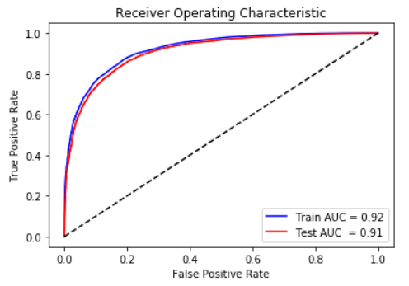
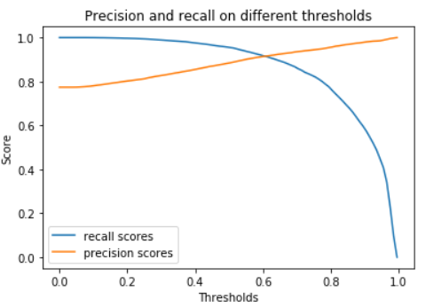
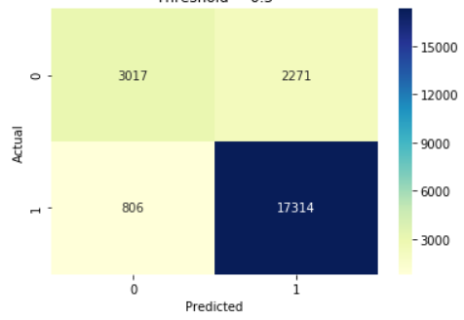
Classifier: RandomForest, depth=9, estimators=100
Test AUC: 0.9100459712606827

Slide 3
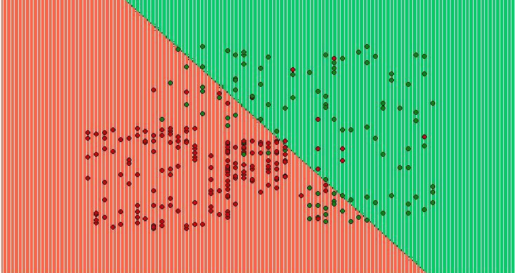
Classifier: Support Vector Regression, Polynomial kernel with degree 3
Mean square error: 5.852445841645441

Slide 4
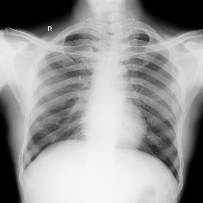
Classifier: ResNet50
Training data: 35000 images
AUC: 0.87

